Slide 1
Outline
What is (Big) Data Architecture?
Big Data Architecture Styles
Data Modeling for Data Warehouse

Slide 2
What is (Big) Data Architecture?

Slide 3
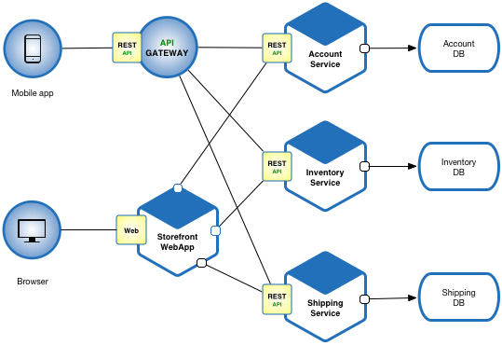
What is Software Architecture?
The set of structures of a software system
  software elements
  the relationships (connections) among them
  externally visible properties of both
The set of principal design decisions made about a software system:
  System structure
  Functional behavior and interaction
  Non-functional properties (quality attributes)
  Implementation
  System goals, stakeholders, and non-technical considerations.
Image credits: https://microservices.io/
Notes:
Architecture is about reasoning-enabling structures.
Module Structures. Here the elements are modules, which are units of implementation. Modules represent a code-based way of considering the system. They are assigned areas of functional responsibility. There is less emphasis on how the resulting software manifests itself at runtime. Module structures allow us to answer questions such as What is the primary functional responsibility assigned to each module? What other software elements is a module allowed to use? What other software does it actually use? What modules are related to other modules by generalization or specialization (i.e. inheritance) relationships?
Component-and-connector structures. Here the elements are runtime components (which are the principal units of computation) and connectors (which are the communication vehicles among components). Component-and-connector structures help answer questions such as What are the major executing components and how do they interact? What are the major shared data stores? Which part of the system are replicated? How does data progress through the system? What parts of the system can run in parallel? How can the system’s structure change as it executes?
Allocation structures. Allocation structures show the relationship between the software elements and the elements in one or more external environments in which the software is created and executed. They answer questions such as What processor does each software element execute on? In what files is each element stored during development, testing, and system building? What is the assignment of software elements to development teams?
The behavior of elements embodies how they interact with each other and with the environment.

Slide 4

Three Architecture Variants of a Model Serving Application
Prediction-UI
Prediction-API
Prediction-UI Embedded
HTTP
Variant 2
Variant 1
Each variant represents a set of design decisions.
What are the implications of them?
Any other possible variants?
Prediction-UI
Prediction-API-GCS
HTTP
Variant 3
Model-Repository

Slide 5
What is Big Data Architecture?
In this course, we consider the software architectures of data-intensive applications and data platforms/infrastructures.
Two definitions:
  “Data architecture is the design of systems to support the evolving data needs of an enterprise, achieved by flexible and reversible decisions reached through a careful evaluation of trade-offs.”[1]
  A data architecture describes how data is managed--from collection through to transformation, distribution, and consumption. It sets the blueprint for data and the way it flows through data storage systems. It is foundational to data processing operations and artificial intelligence (AI) applications. [IBM]
[1] Fundamentals of Data Engineering Book by Joe Reis and Matt Housley

Slide 6
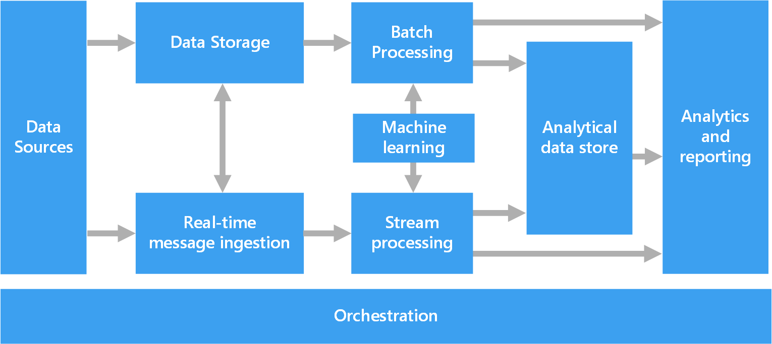
What are the Typical Components of a Big Data Architecture?
Remember this? Batch Processing and Stream Processing;
Monitoring and Governance
https://learn.microsoft.com/en-us/azure/architecture/data-guide/big-data/
Notes:
Most big data architectures include some or all of the following components:
Data sources. All big data solutions start with one or more data sources. Examples include:
Application data stores, such as relational databases.
Static files produced by applications, such as web server log files.
Real-time data sources, such as IoT devices.
Data storage. Data for batch processing operations is typically stored in a distributed file store that can hold high volumes of large files in various formats. This kind of store is often called a data lake. Options for implementing this storage include Azure Data Lake Store or blob containers in Azure Storage.
Batch processing. Because the data sets are so large, often a big data solution must process data files using long-running batch jobs to filter, aggregate, and otherwise prepare the data for analysis. Usually these jobs involve reading source files, processing them, and writing the output to new files. Options include running U-SQL jobs in Azure Data Lake Analytics, using Hive, Pig, or custom Map/Reduce jobs in an HDInsight Hadoop cluster, or using Java, Scala, or Python programs in an HDInsight Spark cluster.
Real-time message ingestion. If the solution includes real-time sources, the architecture must include a way to capture and store real-time messages for stream processing. This might be a simple data store, where incoming messages are dropped into a folder for processing. However, many solutions need a message ingestion store to act as a buffer for messages, and to support scale-out processing, reliable delivery, and other message queuing semantics. This portion of a streaming architecture is often referred to as stream buffering. Options include Azure Event Hubs, Azure IoT Hub, and Kafka.
Stream processing. After capturing real-time messages, the solution must process them by filtering, aggregating, and otherwise preparing the data for analysis. The processed stream data is then written to an output sink. Azure Stream Analytics provides a managed stream processing service based on perpetually running SQL queries that operate on unbounded streams. You can also use open source Apache streaming technologies like Spark Streaming in an HDInsight cluster.
Machine learning. Reading the prepared data for analysis (from batch or stream processing), machine learning algorithms can be used to build models that can predict outcomes or classify data. These models can be trained on large datasets, and the resulting models can be used to analyze new data and make predictions. This can be done using Azure Machine Learning
Analytical data store. Many big data solutions prepare data for analysis and then serve the processed data in a structured format that can be queried using analytical tools. The analytical data store used to serve these queries can be a Kimball-style relational data warehouse, as seen in most traditional business intelligence (BI) solutions. Alternatively, the data could be presented through a low-latency NoSQL technology such as HBase, or an interactive Hive database that provides a metadata abstraction over data files in the distributed data store. Azure Synapse Analytics provides a managed service for large-scale, cloud-based data warehousing. HDInsight supports Interactive Hive, HBase, and Spark SQL, which can also be used to serve data for analysis.
Analysis and reporting. The goal of most big data solutions is to provide insights into the data through analysis and reporting. To empower users to analyze the data, the architecture may include a data modeling layer, such as a multidimensional OLAP cube or tabular data model in Azure Analysis Services. It might also support self-service BI, using the modeling and visualization technologies in Microsoft Power BI or Microsoft Excel. Analysis and reporting can also take the form of interactive data exploration by data scientists or data analysts. For these scenarios, many Azure services support analytical notebooks, such as Jupyter, enabling these users to leverage their existing skills with Python or R. For large-scale data exploration, you can use Microsoft R Server, either standalone or with Spark.
Orchestration. Most big data solutions consist of repeated data processing operations, encapsulated in workflows, that transform source data, move data between multiple sources and sinks, load the processed data into an analytical data store, or push the results straight to a report or dashboard. To automate these workflows, you can use an orchestration technology such Azure Data Factory or Apache Oozie and Sqoop.

Slide 7

Data Ingestion
Data ingestion is the process of moving data from data sources to destination storage(s).
Data ingestion
For Analytics
Source System
Storage
Top stats (e.g., top tweet and top follower) for the last 30 seconds
Monthly overview of top stats
Conversion tracking (for Twitter Ads)
Storage
What should we consider when we ingest Twitter/X data?
Notes:
Key Engineering Considerations for the Ingestion Phase
When preparing to architect or build an ingestion system, here are some primary considerations and questions to ask yourself related to data ingestion:
What’s the use case for the data I’m ingesting?
Can I reuse this data and avoid ingesting multiple versions of the same dataset?
Where is the data going? What’s the destination?
How often should the data be updated from the source?
What is the expected data volume?
What format is the data in? Can downstream storage and transformation accept this format?
Is the source data in good shape for immediate downstream use? That is, is the data of good quality? What post-processing is required to serve it? What are data-quality risks (e.g., could bot traffic to a website contaminate the data)?
Does the data require in-flight processing for downstream ingestion if the data is from a streaming source?

Slide 8
Data Ingestion (Cont’d)
Batch Data Ingestion
  Collecting and ingesting data in predefined, fixed-size chunks or batches periodically or on-demand.
    Time interval-based or Size-based
  Can handle large data volumes efficiently and is simple to implement.
  Unsuitable for real-time applications.
Stream Data Ingestion
  Data is ingested as soon as it is generated at the source systems.
  Suitable for applications that require real-time insights and actions.
  Message Brokers are widely used for buffering and ingesting stream data. (Lecture 9)
Notes:
Batch Data Ingestion Use Cases
Periodic Reporting: Batch ingestion is well-suited for generating periodic reports and analytics based on historical data.
Data Warehousing: Batch ingestion is commonly used for populating and updating data warehouses.
Offline Processing: When real-time insights are not essential, batch ingestion can be employed for various offline data tasks.
Streaming Data Ingestion Use Cases
Real-Time Analytics: Streaming ingestion is ideal for applications that require real-time analytics, such as fraud detection, monitoring, and recommendation systems.
Internet of Things (IoT) Data: Handling high-velocity data streams from IoT devices is a common use case for streaming ingestion.
Event Processing: Streaming ingestion is valuable for real-time event processing, such as social media sentiment analysis or stock market data analysis.
Change data capture (CDC) refers to the process of identifying and capturing changes made to data in a database and then delivering those changes in real-time to a downstream process or system.

Slide 9
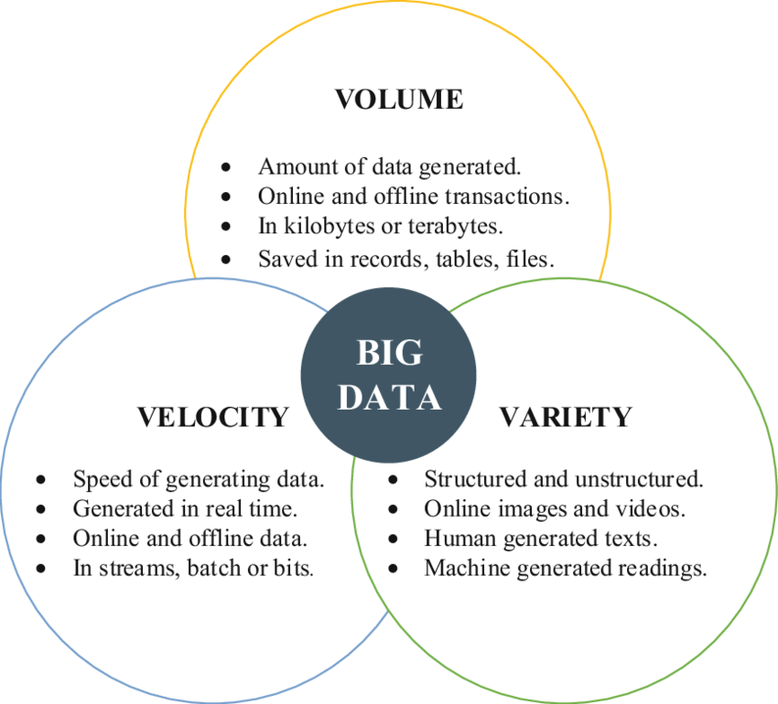
3-Vs and Data Ingestion
What Vs related to batch data ingestion?
What Vs related to stream data ingestion?
Notes:
https://link.springer.com/content/pdf/10.1007/978-981-287-251-7_38.pdf

Slide 10
Data Ingestion (Cont’d)
Ingestion Strategy
  Push (a source system sending data to a target)
  Pull (a target reading data directly from a source)
  Poll (check periodically to detect any changes in the data sources; if Yes, pull)
Pull
Push
Source
Destination
Source
Destination
e.g., Twitter/X streaming API
e.g., Twitter/X Standard search API
Is there a change?
Any examples from Labs for Push Notifications?
Source
Destination
Poll
If Yes, pull
Notes:
https://developer.x.com/en/docs/tutorials/listen-for-important-events

Slide 11
Data Ingestion
Homogeneous data ingestion
  Move the data to the destination in the same format or storage engine as it is in the source - extract and load.
  Use cases:
    Migrating on-premises relational databases or a portion of a database to a cloud relational database as a service (the same data engine and format).
    Data files (e.g., CSV files) ingestion from on-premises storage to a cloud storage bucket (the same format).
    Large objects (BLOB, photos, videos) ingestion into a cloud (object) storage. (the same format).
https://docs.aws.amazon.com/whitepapers/latest/aws-cloud-data-ingestion-patterns-practices/data-ingestion-patterns.html
Notes:
https://docs.aws.amazon.com/whitepapers/latest/aws-cloud-data-ingestion-patterns-practices/data-ingestion-patterns.html

Slide 12
Data Ingestion
Heterogeneous data ingestion
  Data must be transformed as it is ingested into the destination data storage system.
  This requires extract, transform, and load (ETL) workflows.
  Use cases:
    Relational data ingestion between different data engines
    Relational data source to non-relational data destination and vice versa
    File format transformations while ingesting data files (e.g., CSVs to Column-oriented data formats such as Parquet)
https://docs.aws.amazon.com/whitepapers/latest/aws-cloud-data-ingestion-patterns-practices/data-ingestion-patterns.html

Slide 13
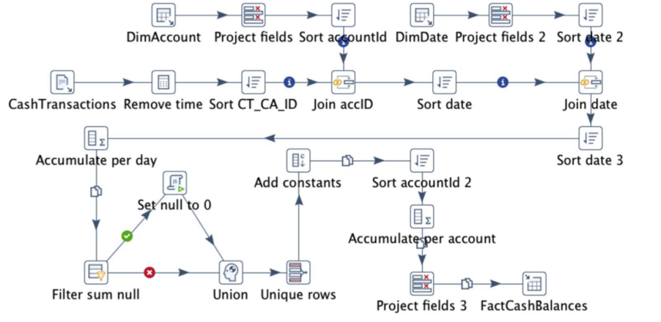
ETL Workflow Example: Cash Balance Population
Data Sources
Data Target
Theodorou, Vasileios, et al. "Frequent patterns in ETL workflows: An empirical approach." Data & knowledge engineering 112 (2017): 1-16.
Notes:
The ETL process extracts data from a plain-text file in the Staging Area (CashTransaction.txt) and processes one of its fields to remove time and keep only date information. Consequently, data are joined with DimAccount table to obtain the corresponding keys for customers and accounts, after irrelevant fields from both sources have been projected out and data have been sorted. Similarly, data are joined with the DimDate dimension table to obtain corresponding date information and then they are aggregated on a daily basis. After null values have been replaced by zeros —only for the rows that contain null values— distinct rows are kept and constants (e.g., effectiveDate) are added to each row. Finally, data are aggregated per account and after keeping only relevant fields, they are loaded to the FactCashBalances table of the DW.

Slide 14
Quiz
Select the most suited data ingestion type for the following use cases.
Alert about possible fraud if the events “login”, “password change”, “new payment” happen sequentially within 5 minutes. Assume the web server at the bank collects all access logs.
Collecting tweets related to Dutch farmers' protests to analyze the people's sentiments on the protests.
Trigger the alarm if the room temperature (averaged over 20 minutes) rises above a threshold. Assume some sensors measure room temperatures.
Assume that each prediction input and its validated response (labels) are stored in a storage bucket by the serving application. We need to trigger the execution of the ML model training pipeline when the new data set has more than 500 rows.
Stream ingestion, push
Batch ingestion, pull
Stream ingestion, push
Batch ingestion, poll /push (event-driven)

Slide 15
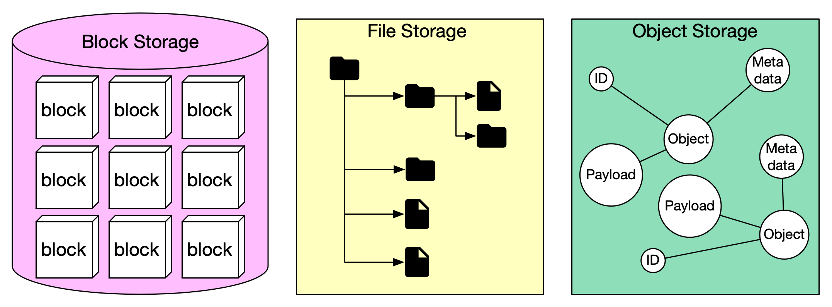
Data Storage : Fundamental Storage
Data can be recorded and stored in three main forms: block storage, file storage, and object storage.
Ref: https://blog.bytebytego.com/p/storage-systems-overview
https://www.ibm.com/blog/object-vs-file-vs-block-storage/
Notes:
File storage is fast and simple. Its hierarchical format makes it good for files that are accessed sequentially. File storage becomes less effective as data volumes expand, however, and can get awkward and slow with too much data.
Block storage is fast and efficient, and well-suited to storage of randomly accessed files that are large—such as application logs or databases. Scaling this type of storage can get expensive, and tracking and searching data can be difficult because of the lack of metadata.
Object storage is infinitely scalable and ideal for unstructured data that is randomly accessed. Its rich metadata makes organizing and accessing data simple and efficient. It is also considered cost-effective because organizations typically pay only for what they use. It’s slower than both file and block storage, however, and is often used for archives and data backups.
Here are some scenarios where each storage type is ideal:
File storage
Shared content repository file storage system
Cloud-based work files for easy collaboration and updates
Machine learning projects, when large volumes of data need to be processed very quickly
Low volume of business files, for simple management and low upfront cost
Block storage
Mission-critical applications, such as ERP and CRM systems
Disaster recovery, for quick and easy restoration
Database storage, for fast data access
High volume of frequently accessed files, especially those that are write-intensive
Object storage
Development of applications and websites
Storage of unstructured data
Managing and analyzing data at the edge
Archival data storage

Slide 16
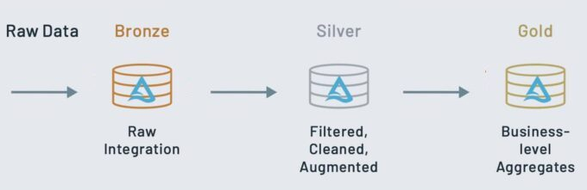
Data Storage : Fundamental Storage (Cont’d)
The data can be logically organized into bronze (raw), silver (validated), and gold (enriched), reflecting the quality of the data.
Data processing pipelines (ETL)
e.g., facts and dimensions, features
In what format (e.g., csv, Parquet), the data should be stored in each layer?
Databricks Medallion Architecture
Apply operations such as aggregations, joins, and filtering.
Notes:
https://learn.microsoft.com/en-us/azure/databricks/lakehouse/medallion
Ingest raw data to the bronze layer
The bronze layer contains unvalidated data. Data ingested in the bronze layer typically:
Maintains the raw state of the data source.
Is appended incrementally and grows over time.
Can be any combination of streaming and batch transactions.
Retaining the full, unprocessed history of each dataset in an efficient storage format provides the ability to recreate any state of a given data system.
Additional metadata (such as source file names or recording the time data was processed) may be added to data on ingest for enhanced discoverability, description of the state of the source dataset, and optimized performance in downstream applications.
Validate and deduplicate data in the silver layer
Recall that while the bronze layer contains the entire data history in a nearly raw state, the silver layer represents a validated, enriched version of our data that can be trusted for downstream analytics.
While Databricks believes strongly in the lakehouse vision driven by bronze, silver, and gold tables, simply implementing a silver layer efficiently will immediately unlock many of the potential benefits of the lakehouse.
For any data pipeline, the silver layer may contain more than one table.
Power analytics with the gold layer
This gold data is often highly refined and aggregated, containing data that powers analytics, machine learning, and production applications. While all tables in the lakehouse should serve an important purpose, gold tables represent data that has been transformed into knowledge, rather than just information.
Analysts largely rely on gold tables for their core responsibilities, and data shared with a customer would rarely be stored outside this level.
Updates to these tables are completed as part of regularly scheduled production workloads, which helps control costs and allows service level agreements (SLAs) for data freshness to be established.
While the lakehouse doesn’t have the same deadlock issues that you may encounter in a enterprise data warehouse, gold tables are often stored in a separate storage container to help avoid cloud limits on data requests.
In general, because aggregations, joins, and filtering are handled before data is written to the gold layer, users should see low latency query performance on data in gold tables.

Slide 17
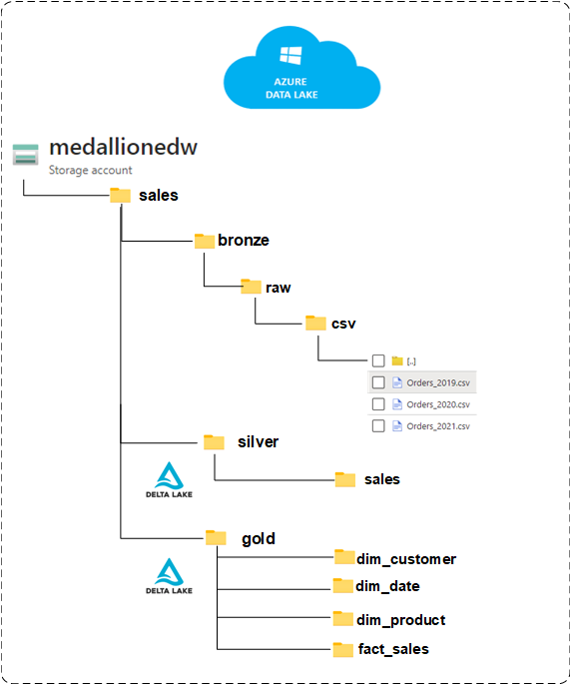
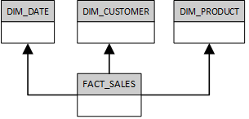
Data Storage : Fundamental Storage (Cont’d)
Storage buckets
Cleaned, transformed, and ordered data (by Order_Date) in Parquet format
Sales conceptual data model
Ref: https://medium.com/@valentin.loghin/medallion-architecture-in-data-lakehouse-with-delta-lake-and-databricks-c463cf251730

Slide 18
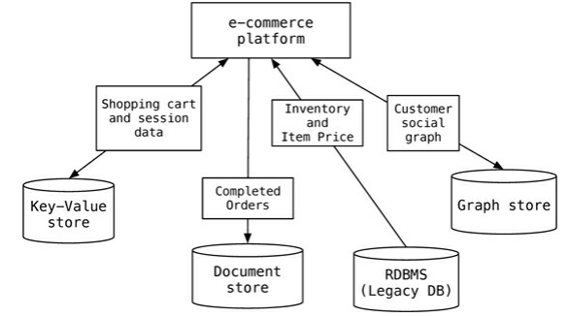
Data Storage: Databases
Polyglot Persistence
Use different database technologies for different kinds of data and data access characteristics:
Need Not Only SQL Databases => NoSQL
https://martinfowler.com/bliki/PolyglotPersistence.html

Slide 19
Types of NoSQL Databases
NoSQL Databases
Key-Value Stores
Document Stores
Graph Databases
Columnar Databases
Notes:
https://aws.amazon.com/compare/the-difference-between-acid-and-base-database
https://docs.aws.amazon.com/whitepapers/latest/choosing-an-aws-nosql-database/types-of-nosql-databases.html

Slide 20
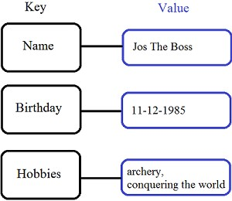
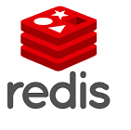
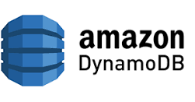
Key-value Store
Simple data model: key/value pairs
The value can be in any format.
Queries are limited to query by key
  get/put/update/delete a key/value pair
  iterate over key/value pairs
Generally, the data cannot be queried by the attributes of the value (Query by data).
Some Key-value stores provide a way to assign a schema for each value/item, sort the data by another key, and query (partially) by data.

Slide 21


Document Stores
Stores and retrieves documents, which can be XML, JSON, etc.
  Similar in nature to a key-value store, but the value is a document
Documents are self-describing, hierarchical tree data structures consisting of maps, collections, and other data structures.
Document databases have a flexible schema, meaning that not all documents in a collection need to have the same fields.
  does not enforce any restrictions on the schema.
Support queries on data by field values. Document databases provide their query languages.
Google
Notes:
Event Logging
Content Management Systems, Blogging Platforms
Web Analytics or Real-Time Analytics
E-Commerce Application
A scalar value is a numerical value, indicating the magnitude of something, while a vector has magnitude and direction. Examples of scalar values are mass, distance, speed, and temperature.

Slide 22
Example of a Simple Query (MongoDB)
Collection orders
{
_id: "a",
cust_id: "abc123",
status: "A",
price: 25,
items: [ { sku: "mmm", qty: 5, price: 3 },
{ sku: "nnn", qty: 5, price: 2 } ]
}
{
_id: "b",
cust_id: "abc124",
status: "B",
price: 12,
items: [ { sku: "nnn", qty: 2, price: 2 },
{ sku: "ppp", qty: 2, price: 4 } ]
}
db.orders.find(
{ status: "A" },
{ cust_id: 1, price: 1, _id: 0 }
)
selection
1 – present
0 – absent
projection
{
cust_id: "abc123",
price: 25
}
In SQL, this would look like:
SELECT cust_id, price
FROM orders
WHERE status="A"

Slide 23
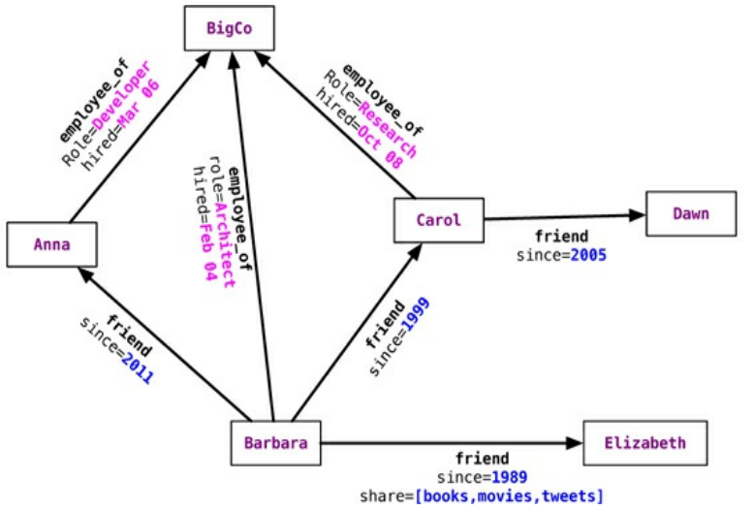


Graph Databases
Store entities and relationships between the entities as a graph.
  Everything is stored as an edge, a node, or an attribute.
The organization of the graph allows the data to be stored once and then interpreted differently based on relationships.
A query on the graph is also known as traversing the graph.
MATCH (:Person {name: 'Carol'})-[:friend]->(p:Person)
RETURN p.name
Find the name of Carol's friend
Sadalage, Pramod J., and Martin Fowler. NoSQL distilled: a brief guide to the emerging world of polyglot persistence. Pearson Education, 2013.

Slide 24
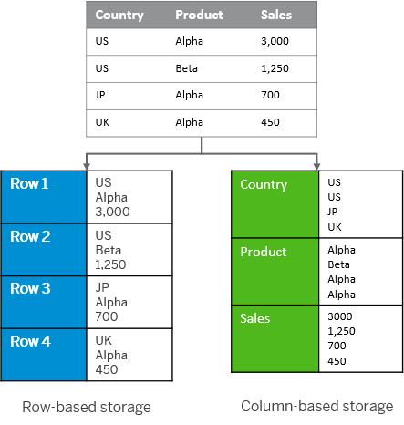


Column Store (Columnar Databases)
Stores data in columns rather than the rows used by traditional databases.
These databases perform particularly well with aggregation queries (such as SUM, COUNT, AVG, etc.).
https://help.sap.com/docs/SAP_HANA_PLATFORM/6b94445c94ae495c83a19646e7c3fd56/bd2e9b88bb571014b5b7a628fca2a132.html
Notes:
Column store
Calculations are typically executed on individual or a small number of columns.
The table is searched based on the values of a few columns.
The table has a large number of columns.
The table has a large number of rows and columnar operations are required (aggregate, scan, and so on)
High compression rates can be achieved because the majority of the columns contain only a few distinct values (compared to the number of rows).
Row store
The application needs to process only one single record at one time (many selects and /or updates of single records).
The application typically needs to access the complete record.
The columns contain mainly distinct values so compression rate would be low.
Neither aggregations nor fast searching are required.
The table has a small number of rows (for example, configuration tables).

Slide 25
Quiz
Consider the following typical data sources a healthcare information system (HIS) uses. Assign the most suited database (including relational databases) for each data source.
  Doctor-patient Interactions (e.g., Consultations and Examinations).
  Relations among symptoms and diagnosis
  Patient photos
  Medical bills
  Financial data
Graph
Graph
Key-value
Document
Relational
Notes:
https://www.geeksforgeeks.org/dbms/how-to-design-er-diagrams-for-online-banking-and-financial-services/

Slide 26
Big Data Architecture Styles
Data Lake
Data Warehouse
Lambda
Kappa
Data Lakehouse
Data Mesh
ADA

Slide 27
Data Lake
Store all types of structured and unstructured data as-is, without having to first format the data.
Other
sources
What is the ideal storage type for data storage?
Analysis
Query
Reports
Data mining
Operational
DBs
Extract
and
Load (EL)
Data Storage
Data Sources
Data Storage
Serving
Transformation
Notes:
Storage: Low-cost flexible (multi-model) storage – can store anything
data masking: the obfuscation of sensitive information so that the database can be used for development and testing purposes. The names and Social Security numbers of individuals in a database might be scrambled with random letters and numerals while still preserving the same length of each string, so that any database testing procedures can work with realistic (yet inauthentic) data.

Slide 28
OLTP vs OLAP
On-Line Transaction Processing – OLTP
  Maintains a database that is an accurate model of some real-world enterprise. Supports day-to-day operations (e.g., making a hotel reservation online or taking cash from an ATM). Characteristics:
    Short simple transactions
    Relatively frequent updates
    Transactions access only a small fraction of the database
On-Line Analytic Processing – OLAP
  Uses information in the databases/data stores to guide strategic decisions (e.g., change product types or their placement in a shop). Characteristics:
    Complex queries
    Infrequent updates
    Transactions access a large fraction of the database
    Data need not be up-to-date
Transaction - A set of related individual operations treated as a single unit.
Notes:
OLTP or online transactional processing is a software program or operating system that supports transaction-oriented applications in a three-tier architecture. It facilitates and supports the execution of a large number of real-time transactions in a database.
OLTP
Automated teller machines (ATMs)
Online banking applications
Online bookings
E-commerce and in-store purchases
Online analytical processing (OLAP) is software technology you can use to analyze business data from different points of view. Organizations collect and store data from multiple data sources, such as websites, applications, smart meters, and internal systems. OLAP combines and groups this data into categories to provide actionable insights for strategic planning. For example, a retailer stores data about all the products it sells, such as color, size, cost, and location. The retailer also collects customer purchase data, such as the name of the items ordered and total sales value, in a different system. OLAP combines the datasets to answer questions such as which color products are more popular or how product placement impacts sales.
Online and in-store credit card payment processing
In computer science, ACID is a set of properties of database transactions intended to guarantee data validity despite errors, power failures, and other mishaps. In the context of databases, a sequence of database operations that satisfies the ACID properties is called a transaction.
ACID is an acronym that refers to the set of 4 key properties that define a transaction: Atomicity, Consistency, Isolation, and Durability.
https://aws.amazon.com/compare/the-difference-between-acid-and-base-database

Slide 29
OLTP and OLAP Example: The Internet Grocer
OLTP-style transaction:
  John Smith, from Schenectady, N.Y., just bought a box of tomatoes; charge his account; deliver the tomatoes from our Schenectady warehouse; decrease our inventory of tomatoes from that warehouse.
OLAP-style transaction:
  How many cases of tomatoes were sold in all northeast warehouses in the years 2000 and 2001?
Can you give an example from Healthcare?
Notes:
From assignment creation to finishing grading, uploading and downloading lecture materials (creating a module, adding multiple tiles, renaming them, etc.)
What is the most popular lab? Who was the most active student in the first week of October?

Slide 30
Data Warehouse Architecture
OLAP (Online analytical processing) is to support ad-hoc querying for the business analysts.
A data mart is a subset of a data warehouse focused on a particular line of business, department, or subject area (Subject-oriented).
OLAP Server
Other
sources
Analysis
Query
Reports
Data mining
Operational
DBs
Extract
Transform
Load (ETL)
Data
Warehouse
Serve
Data Marts
Data Sources
Data Storage
OLAP Engine
Serving
Notes:
Subject-oriented. Support analyzing data about a particular subject or functional area (such as sales).
Most large organizations use a combination of data lakes, warehouses, and marts in their storage infrastructure. Typically, all data is ingested into a data lake then loaded into different warehouses and marts for assorted use cases.
Data marts make specific data available to a defined group of users, which allows those users to quickly access critical insights without wasting time searching through an entire data warehouse. For example, many companies may have a data mart that aligns with a specific department in the business, such as finance, sales or marketing.
Data warehouses typically store data from multiple business units. They centrally integrate data from across the organization for comprehensive analytics. Data marts have a single-subject focus and are more decentralized in nature. They often filter and summarize information from another existing data warehouse
Multiple users and projects require the data stored in data warehouses. Hence, warehouses often have a longer lifespan and are more complex in nature. Data marts, on the other hand, may be project-focused with limited use. Teams prefer creating data marts from the enterprise data warehouse and terminating them once the use case is finished.
https://aws.amazon.com/compare/the-difference-between-a-data-warehouse-data-lake-and-data-mart

Slide 31
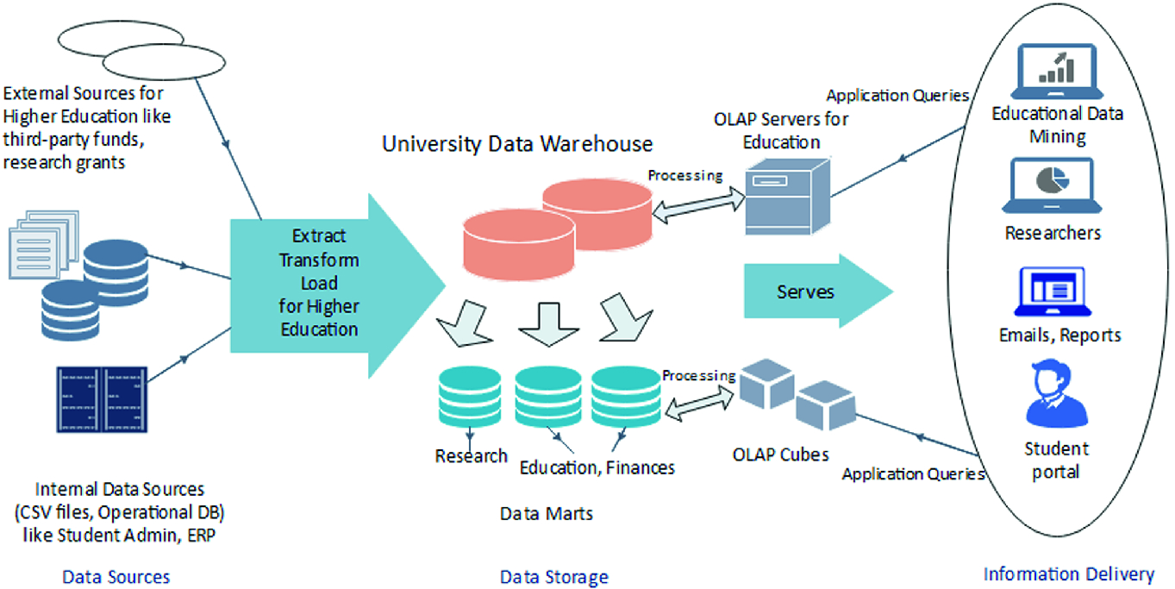
Datawarehouse Example: University Case Study
Suman, S., Khajuria, P., Urolagin, S. (2020). Star Schema-Based Data Warehouse Model for Education System Using Mondrian and Pentaho. In: Goel, N., Hasan, S., Kalaichelvi, V. (eds) Modelling, Simulation and Intelligent Computing. MoSICom 2020. Lecture Notes in Electrical Engineering, vol 659. Springer, Singapore. https://doi.org/10.1007/978-981-15-4775-1_4

Slide 32
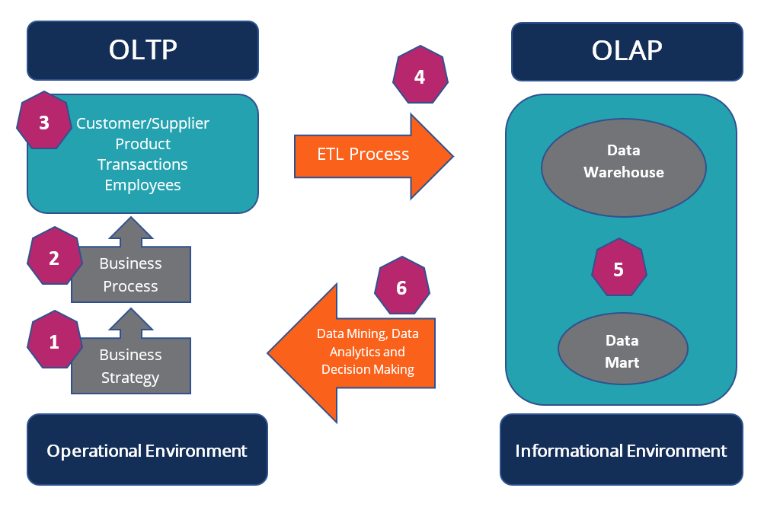
OLTP vs OLAP (Cont’d)
ADA
Course
https://corporatefinanceinstitute.com/resources/data-science/oltp/
Notes:
https://corporatefinanceinstitute.com/resources/data-science/oltp/
1. Business Strategy
The business strategy influences the OLTP systems design. The strategy is formulated at the senior management and the level of the board of directors.
2. Business Process
They are processes by the OLTP system that will accomplish the goals set by the business strategy. The processes comprise a set of activities, tasks, and actions.
3. Product, Customer/Supplier, Transactions, Employees
The OLTP database contains information on products, transactions, employees, and customers, and suppliers.
4. Extract, Transform, Load (ETL) Process
The ETL process extracts data from the OLTP database and transforms it into the staging area, which includes data cleansing and optimizing the data for analysis. The transformed data is then loaded into the online analytical processing (OLAP) database, which is synonymous with the data warehouse environment.
5. Data Warehouse and Data Mart
Data warehouses are central repositories of integrated data from one or more incongruent sources. A data mart is an access layer of the data warehouse that is used to access specific/summarized information of a unit or department.
6. Data Mining, Analytics, and Decision Making
The data stored in the data warehouse and data mart is used for analysis, data mining, and decision making.

Slide 33
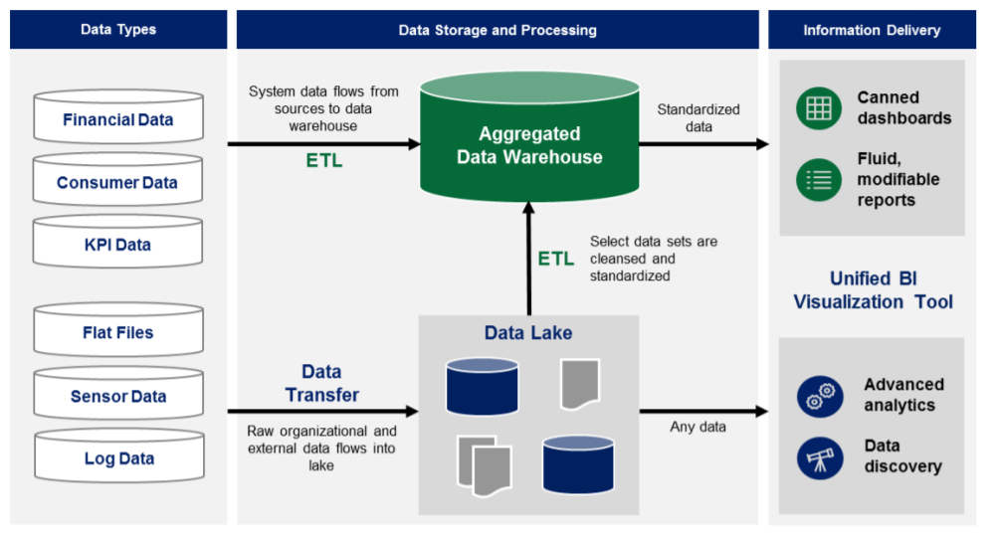
Data Lake and Data Warehouse
source: https://www2.deloitte.com/content/dam/Deloitte/tr/Documents/deloitte-analytics/Modern%20Business%20Intelligence.pdf

Slide 34
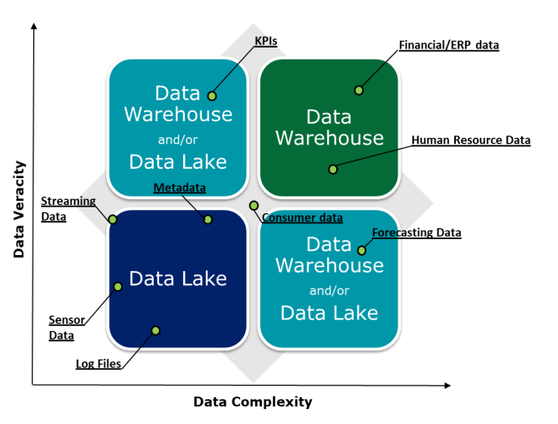
Data Lake and Data Warehouse (Cont’d)
Example use case: generating monthly cost/profit reports
The higher the veracity (accuracy, factual) and complexity of the data set at hand, the more cleansing, transforming, and organizing the data set will require.
Example use case: anomalous activity detection
source: https://www2.deloitte.com/content/dam/Deloitte/tr/Documents/deloitte-analytics/Modern%20Business%20Intelligence.pdf
Notes:
the higher the complexity and
veracity (required precision) of the data, the greater the need to cleanse, transform, and organize
the data. Data lakes offer the ability to do all three, but may not always be the most effective
solution. Given this, there is a tradeoff of having quick access to raw, unfiltered data, or spending
the time to cleanse and prepare data based on business requirements
For example, a monthly costing report which requires auditor precision may be better suited for
development in a traditional data warehousing model where financial subject areas can be
established, calculations are defined, thorough testing completed, and predefined reports built. On
the other side of the business, machine and log data present a classic use case for the data lake.
Log, sensor, and other streaming data are great candidates for data lakes given their semi-
structured and flat, less-complex nature. Often, it does not make sense to spend time modeling,
loading, and converting log data into a reporting structure within the data warehouse. This process
can be arduous, and can be further complicated
when an analysis involves additional data,
requiring additional data modeling and IT
processing. Conversely, loading data into the
data lake can be done with relative ease due to
the limited amount of conversions and
transformations initially required. With the data
lake, open-ended data discovery and analysis
allows any questions to be asked, and data
structures or sets to be determined in support of
those questions on-demand.

Slide 35
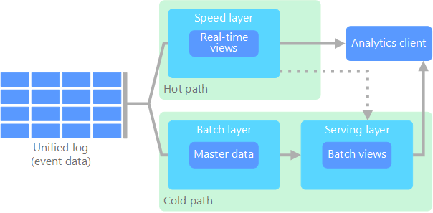
Lambda Architecture
Updates the serving layer with incremental updates based on the most recent data.
Stream data
(Ingestion)
Purpose: To get some results in real-time in addition to the offline analytics.
Hot path (stream processing)
Cold path (batch processing)
Master data represents "data about the business entities that provide context for business transactions" - information about customers, suppliers, employees, stores, etc.
Fed to the batch layer and the speed layer simultaneously
A database storing results
Business Transaction: Buyer X placed an order for 10 of Product Y, on DD-MM-YYYY for a total of $5000.
The buyer and the product are comprised of master data.
https://learn.microsoft.com/en-us/azure/architecture/data-guide/big-data/
https://www.tibco.com/reference-center/what-is-master-data
Notes:
In general, the data captured by businesses falls into one of these three categories:
Transactional data: Transactional data is data that is generated by various applications while running or supporting everyday business processes.
Analytical data: Analytical data, as the name suggests, comes into being through calculations or analyses run on the transactional data.
Master data: Master data represents the actual, critical business objects upon which said transactions are performed, also taking into account the parameters on which data analysis is conducted.
Master Data includes all data stored in your company that are not in motion and are only rarely changed. They represent the basic information about business objects such as products, raw materials, employees, customers, suppliers, investments and similar things that are required for your business operations and processes. In the case of an electricity meter, for example, the meter number and its location are master data. The annual consumption and the meter reading, on the other hand, are transaction data, as they are constantly changing.

Slide 36
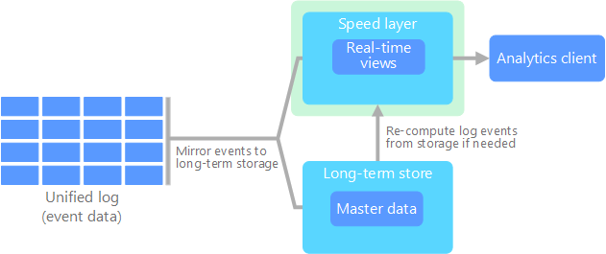
Kappa Architecture
All data flows through a single path using a stream processing system.
Alternative to lambda architecture and avoid duplicate computation logic and the complexity of managing both hot and cold paths.
Stream data
(Ingestion)
may start a new stream processing job to process
Collect data for an X duration and do batch processing to compute the state Y = Incrementally update the state Y over a duration X (at each data point received)
https://learn.microsoft.com/en-us/azure/architecture/data-guide/big-data/
Notes:
The streaming layer supports both batch and real-time processing by the buffering of historical data in a logging system for long enough. When recomputation is required, a new stream processing job is launched alongside an old one. It recomputes the historical data and outputs different results into the Serving layer. After the new job has caught up the old one, back-end systems read from the new result. In addition, the old job is terminated and the corresponding output result is deleted

Slide 37
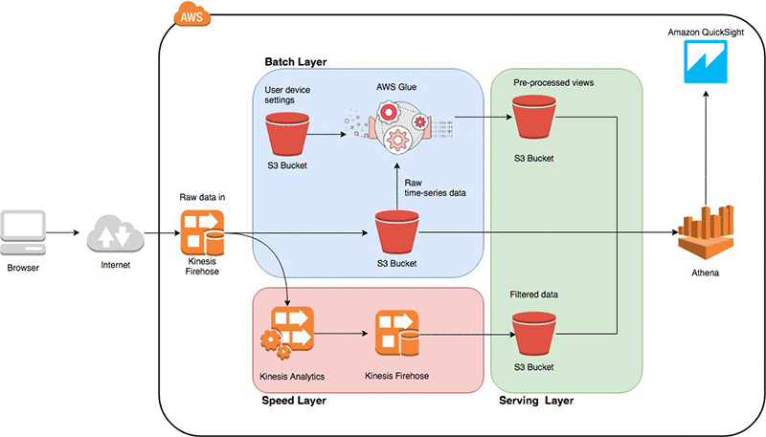
A Lambda Architecture on AWS: Thermostats Sensor Data Processing
Assess thermostat efficiency overtime against the historical data
A good reference use case for Assignment 2
Stream data
(Ingestion)
Detect inefficient sensors in real time
https://aws.amazon.com/blogs/big-data/unite-real-time-and-batch-analytics-using-the-big-data-lambda-architecture-without-servers/
Notes:
Amazon Athena is a serverless, interactive analytics service that provides a simplified and flexible way to analyze petabytes of data where it lives.

Slide 38
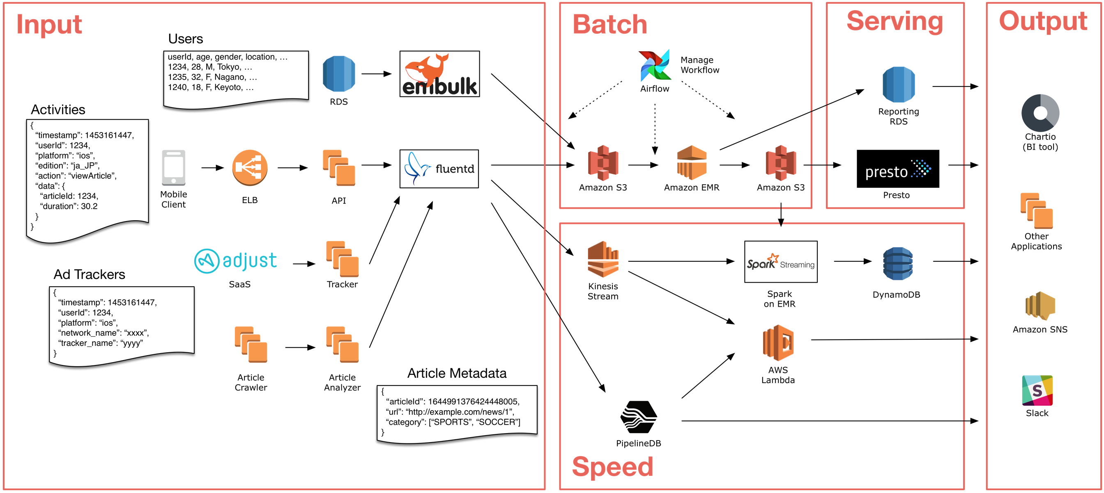
A Lambda Architecture on AWS: SmartNews Use Case
Bulk Data Loader
ETL tasks
Daily
daily aggregation queries, feature engineering, ML
Log collector
more than 60 types of activities
Detect current trending news
Neal real-time (last 5 min)
SmartNews is a machine learning-based news discovery app.
https://aws.amazon.com/blogs/big-data/how-smartnews-built-a-lambda-architecture-on-aws-to-analyze-customer-behavior-and-recommend-content/
Notes:
“SmartNews is a machine learning-based news discovery app that delivers the very best stories on the Web for more than 18 million users worldwide.”
PipelineDB allows you to define continuous SQL queries that perpetually aggregate time-series data and store only the aggregate output in regular, queryable tables.
https://github.com/pipelinedb/pipelinedb
Presto (or PrestoDB) is an open source, distributed SQL query engine, designed from the ground up for fast analytic queries against data of any size.
Amazon Relational Database Service (Amazon RDS) is an easy-to-manage relational database service optimized for total cost of ownership.

Slide 39
Data Modeling for Data Warehouse
Thes slides are based on the Chapter 4 of the book: J. Han, M. Kamber and J. Pei, “Data Mining: Concepts and Techniques”.

Slide 40
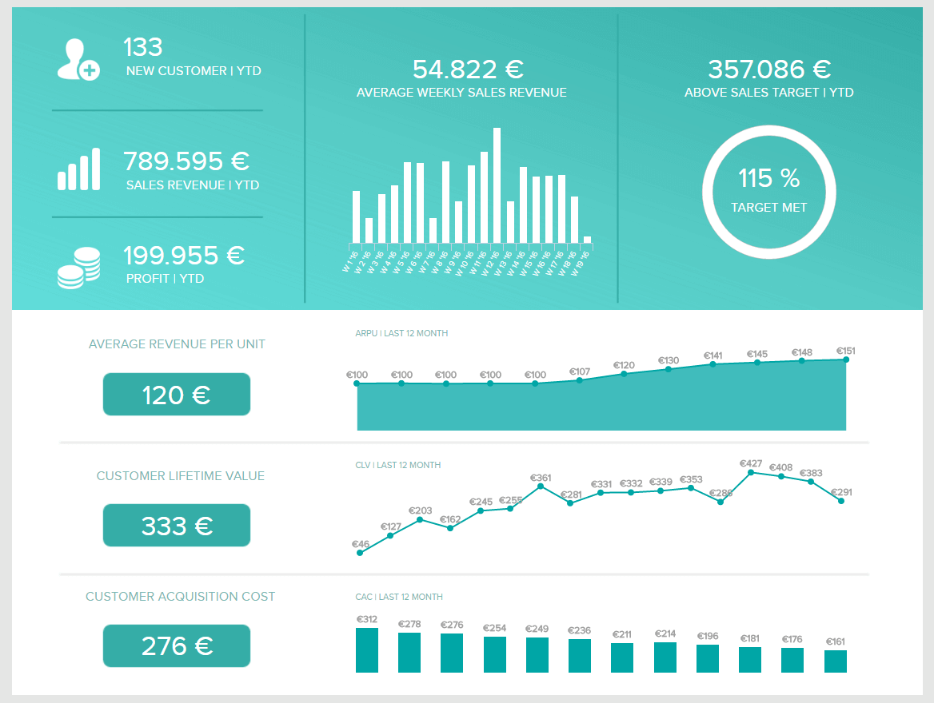
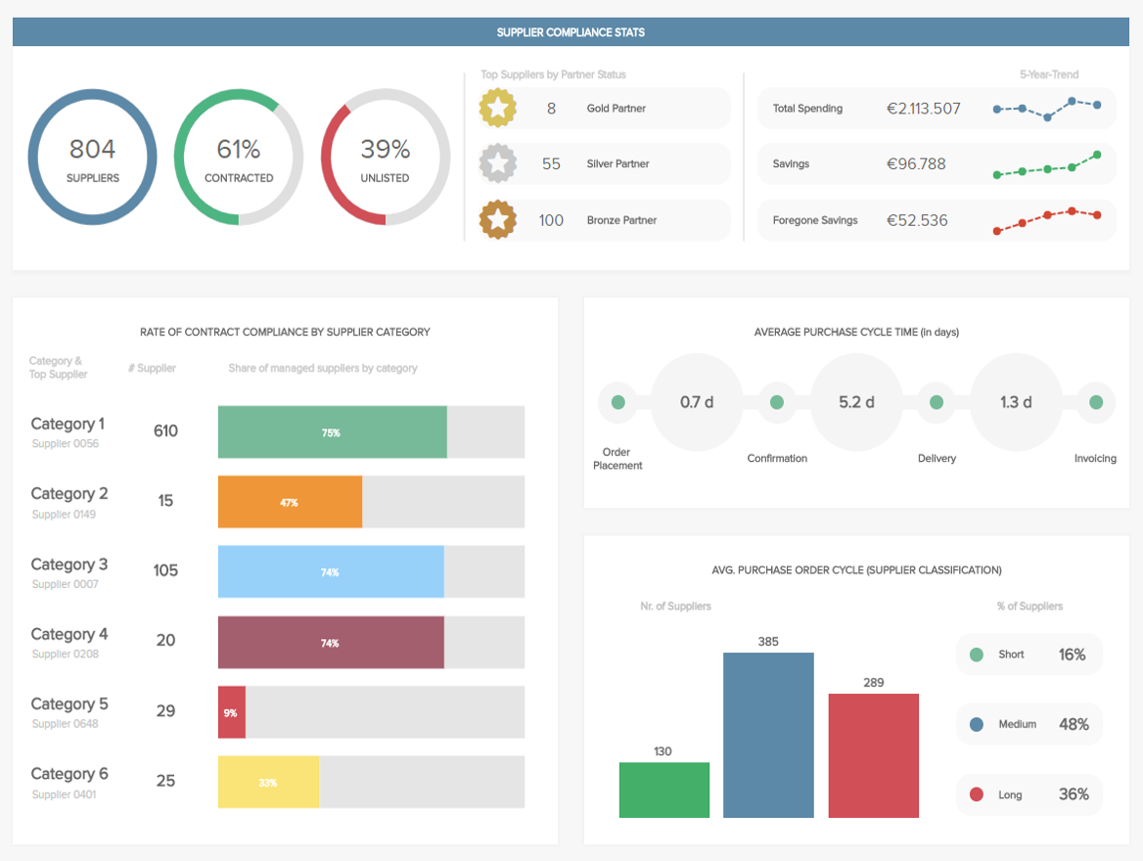
What is Business Intelligence?
Business intelligence (BI) is software that ingests business data and presents it in user-friendly views such as reports, dashboards, charts, and graphs. [IBM]
Business users (e.g., operations and strategy managers) can analyze this information to gain insights into how the business is performing. [IBM]
Subject-oriented: Provides information on a topic (such as sales, suppliers, students, teachers)
A sales report
A procurement dashboard
Ref: https://www.datapine.com/blog/business-intelligence-reporting/
Notes:
https://www.ibm.com/topics/business-intelligence
Business intelligence (BI) is the combination of technologies, strategies, and processes that analyze data to provide actionable insights for better business decision-making. BI tools consolidate data from various sources and present it in easy-to-understand dashboards, reports, charts, and graphs, helping organizations uncover trends, monitor performance, improve operations, and gain a competitive advantag

Slide 41
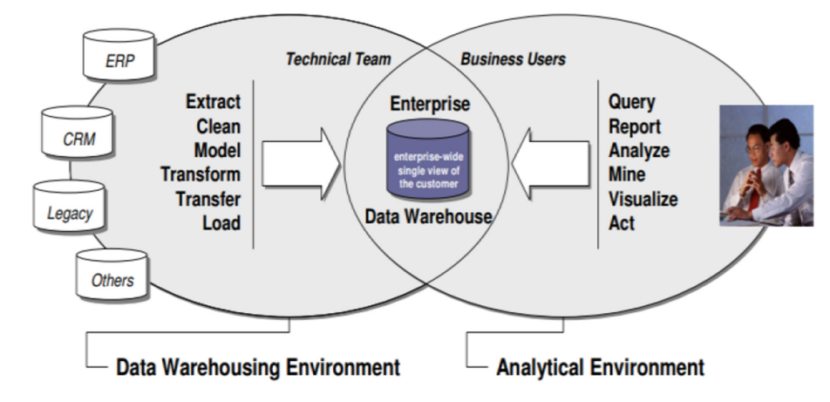
Typical Enterprise BI Environment
Fraihat, Salam, et al. "Business Intelligence Framework Design and Implementation: A Real-estate Market Case Study." ACM Journal of Data and Information Quality (JDIQ) 13.2 (2021): 1-16.

Slide 42
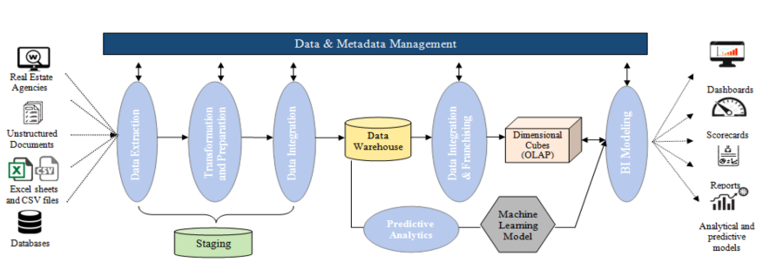
A Typical Data Architecture of a BI Env : A Real Estate Case Study
price prediction
Fraihat, Salam, et al. "Business Intelligence Framework Design and Implementation: A Real-estate Market Case Study." ACM Journal of Data and Information Quality (JDIQ) 13.2 (2021): 1-16.
Notes:
Data extraction sources data from disparate sources including the following: (i) statistical documents and reports, for example, from the land register (these data tend to be unstructured); (ii) data available in spreadsheets and CSV files; (iii) databases of historical prices and market data; and (iv) real estate agencies’ website data. Data cleansing, transformation, and integration take place as part of the “staging” operations. Formatted, clean data are then loaded into the DW. Basic and advanced analytics can then be performed within the DW, including predictive analytics with machine learning algorithms. Furthermore, DW offers OLAP cubes that support the provision of insights via analysis. To design the OLAP cubes, some data franchising and integration operations are performed within DW. The analytics are supported with interactive styles, including scoreboards, reports, predictive models, and interactive dashboards.
Business requirements enumerate the features of the proposed system that cater for problem domain requirements and objectives within the enterprise [34]. The salient business requirements that have been identified in this study are as follows: • To show all real estate properties on a map with sufficiently rich and structured details, such that properties can be assessed according to most common metrics such as price and location. • To summarize and present market trends intuitively, with charts to show price variations over time. • To provide users with the ability to select from a list of various parameters. • To enable users to make predictions according to market specific parameters that can affect sales. • To provide interactive dashboards visualizing data trends, anomalies, and correlations, to make it easy and intuitive to develop an understanding of the market status. Visualizing artifacts assist users in making reliable and quick investment decisions. • To provide information and insights to allow users to find the ideal neighborhoods for maximum return on investment. • To facilitate user ability to make future trends analyses, to be able to decide on length of ownership for maximum profit. • To illustrate the relationships between real estate market factors and property prices. • To provide answers for key decision-affecting questions by similarity and “what-if” analysis. • To provide insights about private sector property rental trends.

Slide 43
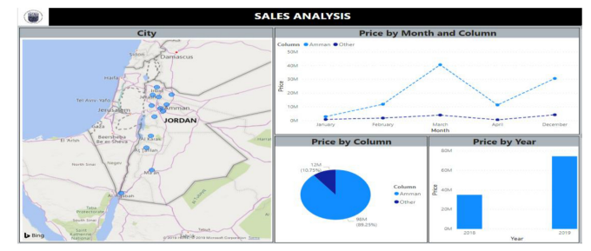
A Typical Data Architecture of a BI Env : A Real Estate Case Study (Cont’d)
Results of OLAP
Month and Year are Dimensions
Avg Sales Price is a measure of a fact.
A Sample Dashboard
Fraihat, Salam, et al. "Business Intelligence Framework Design and Implementation: A Real-estate Market Case Study." ACM Journal of Data and Information Quality (JDIQ) 13.2 (2021): 1-16.
Notes:
Data extraction sources data from disparate sources including the following: (i) statistical documents and reports, for example, from the land register (these data tend to be unstructured); (ii) data available in spreadsheets and CSV files; (iii) databases of historical prices and market data; and (iv) real estate agencies’ website data. Data cleansing, transformation, and integration take place as part of the “staging” operations. Formatted, clean data are then loaded into the DW. Basic and advanced analytics can then be performed within the DW, including predictive analytics with machine learning algorithms. Furthermore, DW offers OLAP cubes that support the provision of insights via analysis. To design the OLAP cubes, some data franchising and integration operations are performed within DW. The analytics are supported with interactive styles, including scoreboards, reports, predictive models, and interactive dashboards.
Business requirements enumerate the features of the proposed system that cater for problem domain requirements and objectives within the enterprise [34]. The salient business requirements that have been identified in this study are as follows: • To show all real estate properties on a map with sufficiently rich and structured details, such that properties can be assessed according to most common metrics such as price and location. • To summarize and present market trends intuitively, with charts to show price variations over time. • To provide users with the ability to select from a list of various parameters. • To enable users to make predictions according to market specific parameters that can affect sales. • To provide interactive dashboards visualizing data trends, anomalies, and correlations, to make it easy and intuitive to develop an understanding of the market status. Visualizing artifacts assist users in making reliable and quick investment decisions. • To provide information and insights to allow users to find the ideal neighborhoods for maximum return on investment. • To facilitate user ability to make future trends analyses, to be able to decide on length of ownership for maximum profit. • To illustrate the relationships between real estate market factors and property prices. • To provide answers for key decision-affecting questions by similarity and “what-if” analysis. • To provide insights about private sector property rental trends.
facts are the data points that get tracked, analyzed, and reported. They are the objective, quantifiable metrics that businesses measure to evaluate their performance.
Measures take the raw, often overwhelming pile of facts and transform them into clear, digestible insights. If facts are the individual notes played by an orchestra, measures are the symphony that emerges.
They're all about calculation and aggregation, turning "how many" and "how much" into "here's what it means."
For example, each sale is a fact. But when you start asking, "What's our best-selling product?" or "How much does each customer spend on average?", you're stepping into the realm of measures. These are the answers you get after mixing, stirring, and baking your facts.

Slide 44
Data Warehouse Data Modeling
Data warehouses use multidimensional data models that view data as data cubes.
  Some examples of Dimensions are product (product_name, brand, type), and time (day, week, month, quarter, year)
  For one or more dimensions, the facts are measured (such as dollars_sold and units_sold)
The dimensional modeling was introduced by Ralph Kimball (1994)
Common measure types?
We can answer questions such as:
What are sales (amount) for our eastern region versus our western region this year, compared to last year?
What is the quarterly contribution of research papers by each unit in JADS?
Notes:
count(), sum(), min(), max()
avg(), min_N(), standard_deviation()
Rank()
A dimension is a structure that categorizes facts and measures in order to enable users to answer business questions. Commonly used dimensions are people, products, place and time.
Most often, OLAP measure meaning is a numeric value by which the dimension is detailed or aggregated. It specifies a certain OLAP dimension and answers the “How much…?” question. For example, information about totaled bike sales is set out in one of the measures.
Dimensions are essentially the descriptive attributes associated with fact data that enable analysts to answer the who, what, where, when, why, and how of any business operation. They are the metadata that brings color to the black-and-white figures of the facts.

Slide 45
Multidimensional Data
Sales volume as a function of product, month, and region
Dimensions: Product, Location, Time
Hierarchical summarization paths
Region
Industry Region Year
Category Country Quarter
Product City Month Week
Office Day
Product
Month

Slide 46
A Sample Data Cube
Date
Total annual sales
of TVs in U.S.A.
1Qtr
2Qtr
3Qtr
4Qtr
sum
Product
TV
PC
c
U.S.A
VCR
sum
Canada
a
Country
Mexico
What are a, b, and c?
sum
b
All, All, All
Notes:
A – all products, USA in 3rd qtr
B - all products, all countries in 4th qtr
C- PC, 2nd Qtr, USA

Slide 47
Typical OLAP Operations
Roll up (drill up): summarize data
  by climbing up the hierarchy or by dimension reduction
Roll down (drill down): reverse of roll-up
  from higher level summary to lower level summary or detailed data, or introducing new dimensions
Slice and dice: project and select
Pivot (rotate):
  reorient the cube, visualization, 3D to series of 2D planes

Slide 48
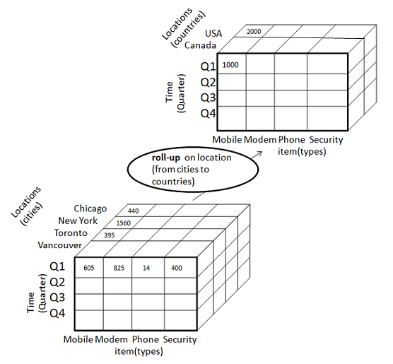
Rollup
2000 =
440 (Chicago) + 1560 (New York)
1000 = 395 (Toronto) + 605 (Vancouver)
Industry Region Year
Category Country Quarter
Product City Month Week
Office Day
https://www.tutorialspoint.com/dwh/dwh_olap.htm

Slide 49
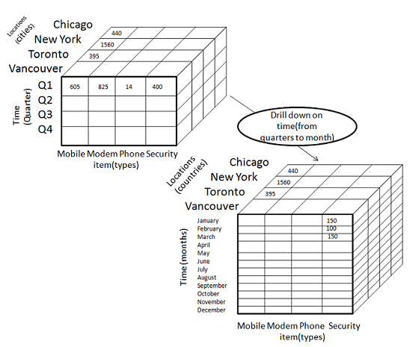
Drill Down
400 (Q1) = 150 (Jan) + 100 (Feb) + 150 (March)
Only show one example
Industry Region Year
Category Country Quarter
Product City Month Week
Office Day
https://www.tutorialspoint.com/dwh/dwh_olap.htm

Slide 50
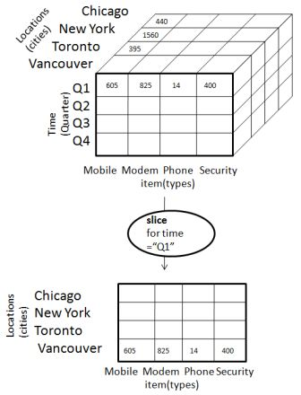
Slice
The slice operation selects one particular dimension from a given cube and provides a new sub-cube.
Only show the values for Vancouver
https://www.tutorialspoint.com/dwh/dwh_olap.htm

Slide 51
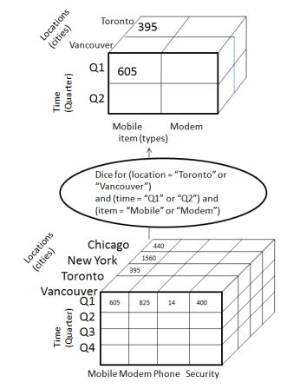
Dice
Only show the values for Q1
Dice selects values for two or more dimensions from a given cube and provides a new sub-cube.
https://www.tutorialspoint.com/dwh/dwh_olap.htm

Slide 52
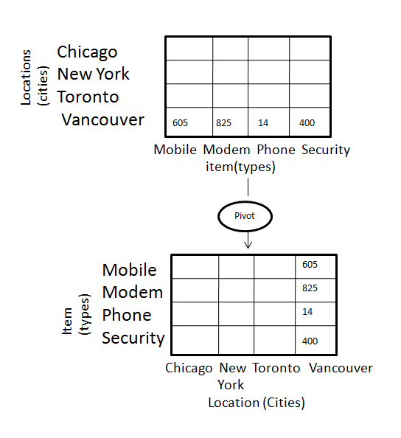
Pivot
The item and location axes in a 2-D slice are rotated.
Rotates the data axes in view in order to provide an alternative presentation of data.
https://www.tutorialspoint.com/dwh/dwh_olap.htm

Slide 53
Conceptual Modeling of Data Warehouses: Implementing Data Cubes
Modeling data warehouses: dimensions & measures
  Star schema: A fact table in the middle connected to a set of dimension tables
  Snowflake schema: A refinement of star schema where some dimensional hierarchy is normalized into a set of smaller dimension tables, forming a shape similar to snowflake
  Fact constellations: Multiple fact tables share dimension tables, viewed as a collection of stars, therefore called galaxy schema or fact constellation

Slide 54
Example of Star Schema
time
time_key
day
day_of_the_week
month
quarter
year
item
item_key
item_name
brand
type
supplier_type
Sales Fact Table
time_key
item_key
branch_key
branch
location
location_key
branch_key
branch_name
branch_type
location_key
street
city
state_or_province
country
units_sold
dollars_sold
avg_sales
Measures

Slide 55
Example of Snowflake Schema
time
item
time_key
day
day_of_the_week
month
quarter
year
item_key
item_name
brand
type
supplier_key
supplier
Sales Fact Table
supplier_key
supplier_type
time_key
item_key
branch_key
branch
location
location_key
location_key
street
city_key
branch_key
branch_name
branch_type
units_sold
dollars_sold
city
city_key
city
state_or_province
country
avg_sales
Measures
Notes:
https://learn.microsoft.com/en-us/office/troubleshoot/access/database-normalization-description

Slide 56
Example of Fact Constellation
time
time_key
day
day_of_the_week
month
quarter
year
item
Shipping Fact Table
item_key
item_name
brand
type
supplier_type
Sales Fact Table
time_key
time_key
item_key
shipper_key
item_key
branch_key
from_location
branch
location_key
location
to_location
branch_key
branch_name
branch_type
units_sold
location_key
street
city
province_or_state
country
dollars_cost
dollars_sold
units_shipped
avg_sales
shipper
Measures
shipper_key
shipper_name
location_key
shipper_type

Slide 57
Selection of Schema
Data Warehouse
  The fact constellation schema is commonly used as it can model multiple, interrelated subjects (e.g., sales, shipping, and manufacturing).
Data marts
  The star or snowflake schema is commonly used as the scope of a data mart is one or few subjects.
    The star is the most popular and efficient.
Notes:
https://stackoverflow.com/questions/2623852/why-are-joins-bad-when-considering-scalability

Slide 58

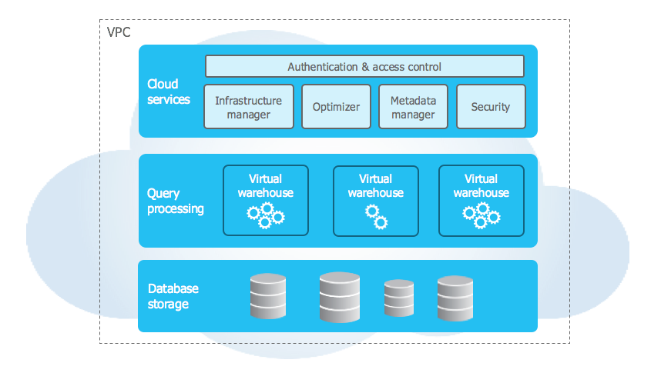
Snowflake
(not for exams)
Snowflake data platform is a cloud-based data warehouse solution (PaaS).
Snowflake vs BigQuery: A Comprehensive Comparison
https://medium.com/google-bigquery/snowflake-vs-bigquery-a-comprehensive-comparison-9d30c99f1c1b
Separation of compute from storage
https://www.snowflake.com/en/emea/
https://docs.snowflake.com/en/user-guide/intro-key-concepts
Notes:
Separating storage from compute is an architecture where data storage resources are managed independently from the processing (compute) resources. This approach allows for independent scaling of compute and storage, provides better resource isolation, reduces costs by allowing specialized hardware and paying only for usage, and increases flexibility for different workloads.
How it works
Data storage: Data is stored in a central, often low-cost, remote storage system like cloud object storage (e.g., Amazon S3, Google Cloud Storage) or a network-attached storage (NAS).
Compute nodes: Compute nodes (or clusters) are separate and connect to the storage to retrieve the data needed for processing queries.
Query processing: When a query is submitted, a compute node fetches the necessary data from the remote storage, processes it (e.g., performs joins or aggregations), and returns the results.
Caching: To improve performance, a local cache on the compute nodes is often used to store frequently accessed data.

Slide 59
Recap
We discussed the key components of big data architecture, particularly data ingestion, storage, and analytical data modeling.
We discussed the several big data architecture styles.

